Slide 1

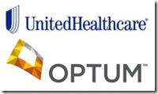
How Healthcare Algorithms Can Reinforce Inequality How Healthcare Can Reinforce Inequality
Tiara Scott
Itai 2372
This Photo by Unknown Author is licensed under CC BY-SA

Slide 2
Who is Optum?
Optum is a healthcare technology and services company that uses data and analytics to improve healthcare systems.
Optum is owned by UnitedHealth Group, one of the largest healthcare companies in the U.S.
Optum plays a major role in healthcare by:
Serving millions of patients
Working with hospitals and insurers
Managing pharmacy services
Using AI and big data to analyze healthcare systems

Slide 3
Optum operates in 3 divisions
Optum Health
Optum Insight
Optum RX
Optum Insight is most relevant to this case.
Optum Insight
Because government programs like Medicare and Medicaid heavily rely on these analytics, companies like Optum can indirectly influence:
How risk scores are calculated
How reimbursement formulas are structured
3. how fraud detection systems operate
Optum Insight
Optum insight provides:
1. Healthcare cost modeling
2. Risk adjustment analytics
3. Population health data

Slide 4
What is a risk score ?
A risk score predicts how much medical care a patient ,might need in the future.
Risk scores estimate:
Likelihood of hospitalization
Future healthcare needs
Expected treatment costs
Why Risk Scores can be Dangerous
Risk scores influence major decisions like:
Who gets extra care/monitoring
Who receives care management
Who gets preventative care
If the model is biased, the risk score will be biased
Notes:
Optum Regarding AI
1. Optum uses predictive analytics for patient risk score.
Patient risk scores enables health systems to categorize each patient based on their health status.
2. Optum uses NLP to analyze medical records.
3. Develops population health models.

Slide 5
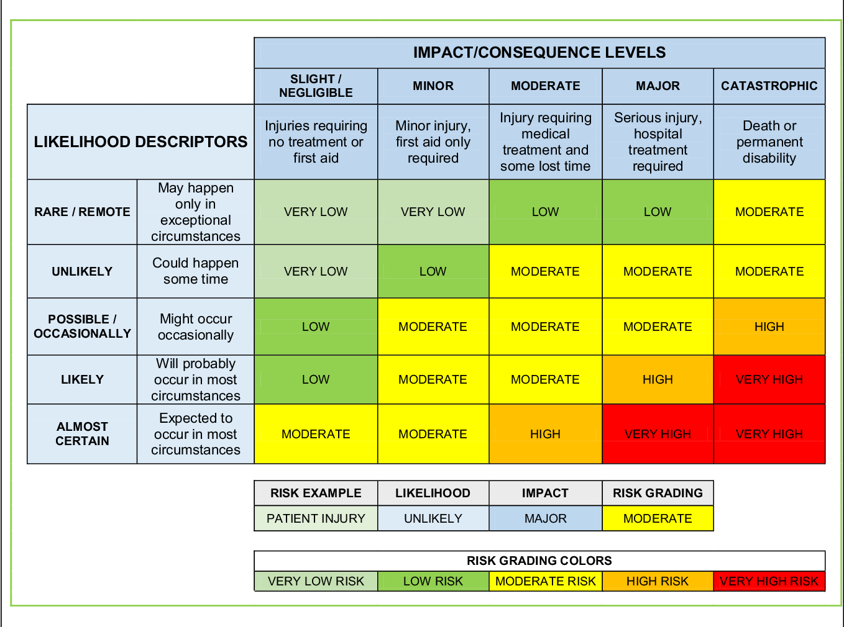
Example
Let’s say a model predicts:
P(Hospitalizations in 12 months)
If the model outputs:
0.82 → that’s an 82% predicted chance the patient will get hospitalized in 12 months
0.10 = Low risk
0.50 = Moderate Risk
0.90 = High risk
Hospitals may then::
1. Flag that patient for extra monitoring
2. Assign a case manager
3. Offer preventative service

Slide 6
The Discovery
In October of 2019, a study published in Science revealed that a widely used commercial healthcare algorithm contained a significant bias.
The algorithm was used by insurers, hospitals, and health systems all over the United states to see which patients would benefit from programs for those who are need “high-risk care management”.
This algorithm was estimated to affect more than 200 million people a year.
On the surface, the algorithm appeared race-neutral; however, the bias emerged from what it did use: healthcare cost as a proxy for health need.
The bias was not cause by intentional programming, but by the proxy variable used in the model. A proxy variable is a variable used to stand in for another variable that you cannot directly measure.
Scientists used the algorithm used by hospitals and health systems to decide which patients needed extra medical help.
The program was found to be unfair to black patients because it tended to think black patients were less sick than they really were – even though they were just as sick as white patients.
Why did this happen?
The algorithm did not try to measure how someone was, instead it looked at how much money the health system spent on that person’s care and used healthcare costs as a proxy for sickness.
If a patient had many doctor visits, test, or treatments, the algorithm believed they were sicker.
Because black patients historically accessed care less often, received fewer referrals, and were less likely to have their symptoms taken seriously in comparisons to white patients ( for reasons such as structural barriers, unequal access, implicit bias, insurance disparities, provider bias, and historical mistrust) the program thought black patients were healthier than they were.

Slide 7
Where the Bias Came From
Proxies
In data science and machine learning proxies are used when:
1. The real variable is hidden
2. The real variable is cannot be directly measured.
3. The real variable was not collected in the dataset.
Example: Proxy Variable
If you want to know how rich someone is, but you cannot see their bank account you might look at:
The neighborhood they live in.
The car they drive.
The size of their house.
The things listed above are not money, but they give clues about money. Those clues are proxy variables
Why proxies can be dangerous
They might not perfectly represent the real things.
2. They can introduce bias.
3. They can accidentally encode sensitive attributes (race, gender, age, religion, or health status).
4. They can lead to wrong conclusions.
Example: Machine Learning Bias
- Sometimes proxy variables cause hidden bias.
A model is not allowed to use race, but it uses zip code. If the zip code strongly correlates with race, then the zip code becomes a proxy for race.
> even though the race wasn’t included, the model still indirectly used it.

Slide 8
The Data
Black patients assigned the same risk score as white patients, on average, had more chronic illnesses
These illnesses included diabetes, dementia, renal failure, and hypertension.
For black patients to be referred to high-risk management programs at the same rate as white patients, black patients had to be significantly sicker at the point of enrollment.
Researchers discovered that the biased reduced the proportion of black patients receiving extra care by half.
Correcting the algorithm increased black patient enrollment in care management programs from 17.7% to 46.5%.
* Across the entire population studied, roughly 56,000 additional black patients per year would have qualified for extra care under a correct model.
For AI development, the case is an example of how historical data encodes historical injustice.
Training on real-world data does not produce objective models, it produces models that reflect and amplify the inequities that are present in data .
In other words, fairness must be designed. It does not emerge automatically.
This case accelerated conversations around algorithmic accountability in healthcare.
- The proposed Algorithmic Accountability Act (explain on notes) in the U.S. Congress directly cited health algorithm bias as a motivating concern.
Notes:
Explain what the Algortithmic Accountability Act is
Explain the philosophy of fairness.

Slide 9
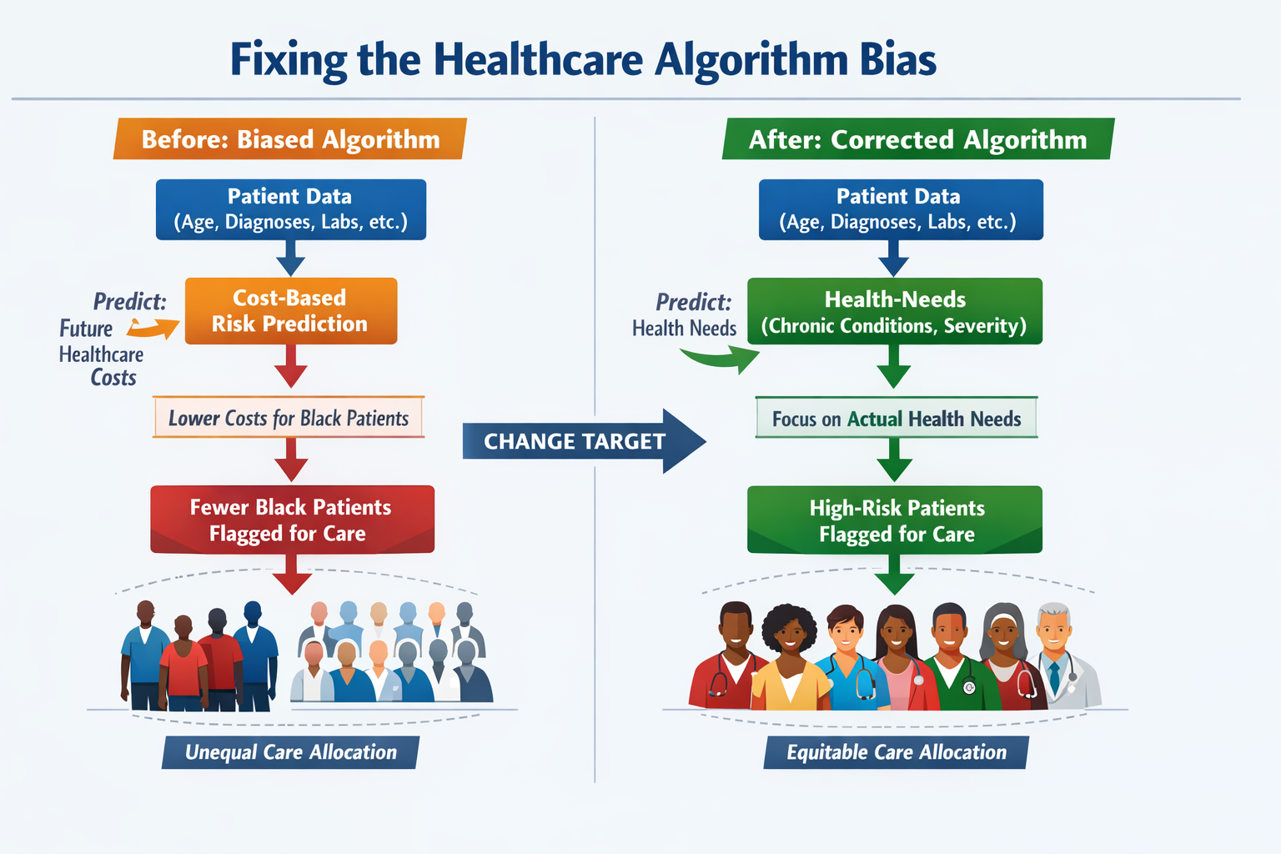
The Fix
Fixing the Algorithm
1. Change the outcome variable
2. Remove the cost-based proxy
3. Continuous Auditing and Retraining:
4. Incorporate Socio-economic data
5. Human-in-the-Loop Oversight
Notes:
Explain the impact of the fix

Slide 10
Takeaways
This case remains one of the most important AI ethics cases.
This is because the bias was not a result of malicious intent.
Nobody set out to disadvantage black patients. The harm emerged from a series of seemingly reasonable design choices, which was to:
1. use available data
2. optimize for a measurable proxy
3. deploy at scale
Those decisions were made without concern of what that data represented or who would be affected from the cost of errors.
The case shows and warns how the most dangerous AI failures are not often dramatic.
They are:
Quiet
Statistically embedded
Affect millions of people before anyone even notices
Key Lesson:
1. AI systems are not automatically fair.
2. When models are trained on historical data, they can replicate historical inequalities.

Slide 11
Resources Used
Obermeyer, Z., Powers, B., Vogeli, C., & Mullainathan, S. (2019).
Dissecting racial bias in an algorithm used to manage the health of populations.
Science.
Paul, K. (2019).
Healthcare algorithm used across America has dramatic racial biases.
The Guardian
Kennedy, S. (2023).
Explaining the basics of patient risk scores in healthcare.
TechTarget

